Slide 1
Getting Started with Windows Server 2019
Module 1
Notes:
Add slide notes here

Slide 2
Learning Objectives (1 of 2)
After completing this module you should be able to:
Summarize the different ways that Windows Server 2019 can be used within an on-premises or cloud environment
Explain the purpose and function of Windows virtual machines and containers
Outline the key features of Windows Server 2019
Identify the differences between Windows Server 2019 editions
Discuss the considerations necessary to plan for a Windows Server 2019 installation
Notes:
Add slide notes here

Slide 3
Learning Objectives (2 of 2)
After completing this module you should be able to:
Describe the concepts and processes used to perform a Windows Server 2019 installation
Outline common post-installation configuration tasks for Windows Server 2019
Identify the different virtualization configurations that can be used to explore Windows Server 2019 within an IT lab environment
Notes:
Add slide notes here

Slide 4
Using Windows Server 2019 within an Organization (1 of 2)
Computer networks and the Internet in the 1990s
PCs (client) connected to other computers across a computer network
Obtained access to shared resources
Server: computer that shared the resource
On-premises servers, cloud servers, rackmount servers, blade servers
Rack servers (1U and 2U)
Storage area network (SAN) devices, uninterruptible power supply (UPS) devices

Slide 5
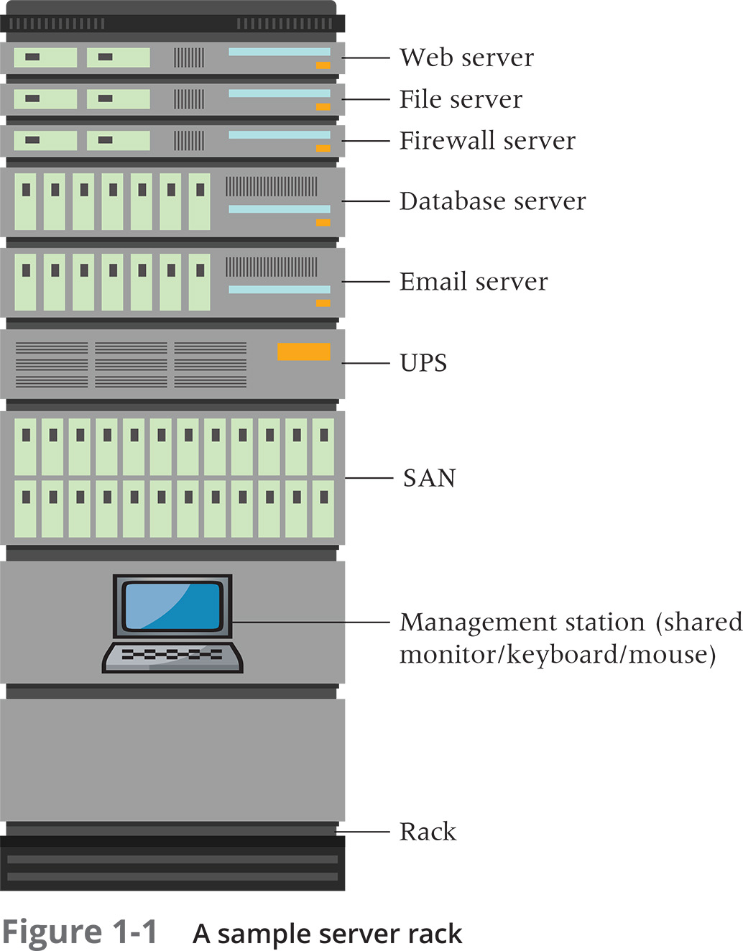
Using Windows Server 2019 within an Organization (2 of 2)

Slide 6
Understanding Windows Server Virtualization (1 of 4)
Virtualization
Process of running more than one operating system at the same time on a single computer
Requires hypervisor software
Type 2 hypervisors run on top of an existing workstation operating system
Type 1 hypervisors interact with the hardware directly
Contain a small operating system to manage the hypervisor configuration and virtual machines
Example: Microsoft Hyper-V

Slide 7
Understanding Windows Server Virtualization (2 of 4)
Hypervisor requirements
Hypervisor acceleration
Second Level Address Translation (SLAT) extensions
Virtual machine configuration file
Stored within a file specific to the hypervisor
Operating system virtual hard disk file
Thick provisioning: allocates fixed space for the file when created
Thin provisioning: dynamically allocating space as needed

Slide 8
Understanding Windows Server Virtualization (3 of 4)
On-premises and cloud operating systems
Virtual machines with virtual hard disk files hosted on a SAN within the organization or cloud data center
Nested virtualization
Running other virtual machines within an existing virtual machine
Example: Hyper-V
Provides ability to implement a more complex virtualization structure
Provides ability to create complex virtualization structure on Windows 10 PCs for learning and testing purposes

Slide 9
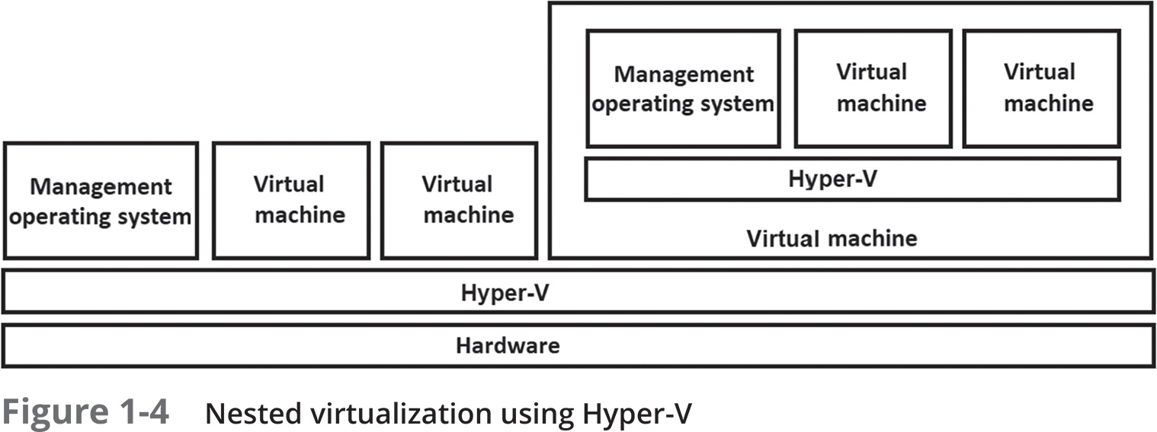
Understanding Windows Server Virtualization (4 of 4)

Slide 10
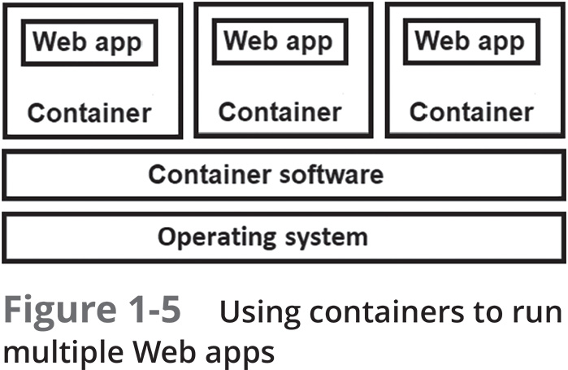
Understanding Windows Containers (1 of 3)
Notes:
Container
Subset of an operating system composed of one or more Web apps and the supporting operating system files needed by those Web apps only
Containers must be run on an existing operating system that has container software installed

Slide 11
Understanding Windows Containers (2 of 3)
Sandboxing
Enclosing executed Web apps in a way that isolates them from Web apps running within other containers and the underlying operating system
Docker: common container software
Windows Containers: Windows Server component needed to use Docker
Kernel: core operating system component
Hyper-V containers
Provide additional performance and security features to Web apps

Slide 12
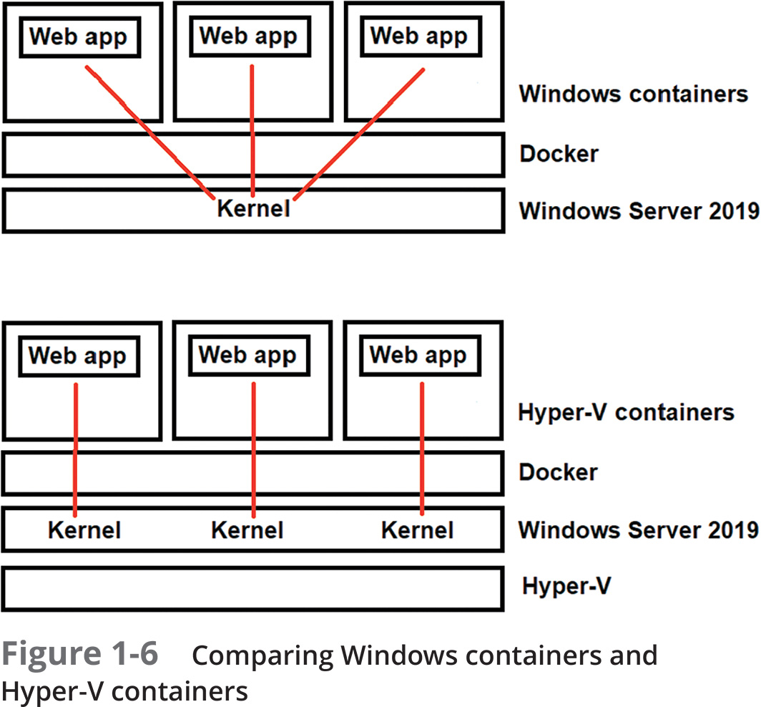
Understanding Windows Containers (3 of 3)

Slide 13
Windows Server 2019 Features (1 of 11)
Active Directory
Provides single sign-on using domain and domain controller environment
Windows Server as an Active Directory domain controller
Provides single sign-on for other computers joined to a domain
Contains Group Policy and Active Directory Certificate Services features
Azure Active Directory
Service hosted within Microsoft’s Azure cloud
Provides Active Directory services to an organization

Slide 14
Windows Server 2019 Features (2 of 11)
Security
Microsoft Defender Advanced Threat Protection (ATP)
Performs deeper inspection of files and processes
Shielded virtual machines feature protects Hyper-V virtual hard disk files
More emphasis on Internet Information Services (IIS) Web server software
Additional basic security features
File and folder permissions, security policies, encryption of data, event auditing, various authentication methods, server management and monitoring tools

Slide 15
Windows Server 2019 Features (3 of 11)
Volume and filesystem features
NTFS features
Built-in support for file and folder permissions, compression, Encrypting File System (EFS) encryption, user quotas, data deduplication, journaling, self-healing capability
ReFS v3 features
Data deduplication, improved performance with Storage Spaces
Storage Replicas have better performance
Storage Migration Service simplifies the moving of data

Slide 16
Windows Server 2019 Features (4 of 11)
Performance and reliability features
Privileged mode
Protected processes
Multitasking
Multithreading
Processor scalability
Server clustering

Slide 17
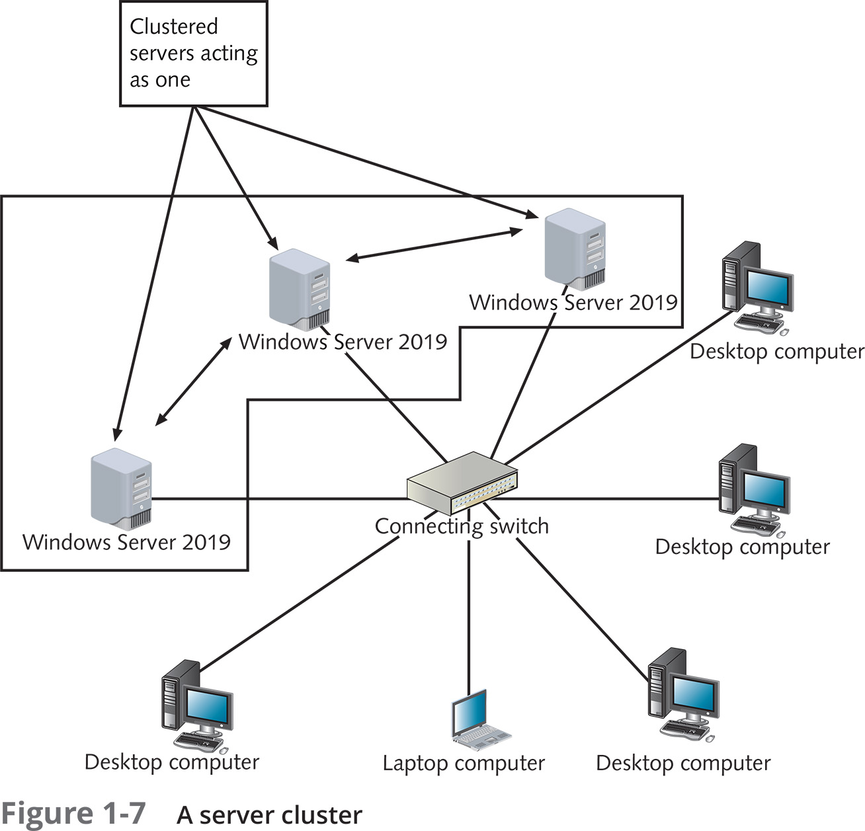
Windows Server 2019 Features (5 of 11)

Slide 18
Windows Server 2019 Features (6 of 11)
Administration tools manage the servers and services on the network
Server Manager
Monitors and manages server local configurations or network servers
MMC snap-in performs most configurations
Windows PowerShell
Provides features for computers running Windows and Windows Server
Windows Admin Center
Web-based management tool new to Windows Server 2019

Slide 19
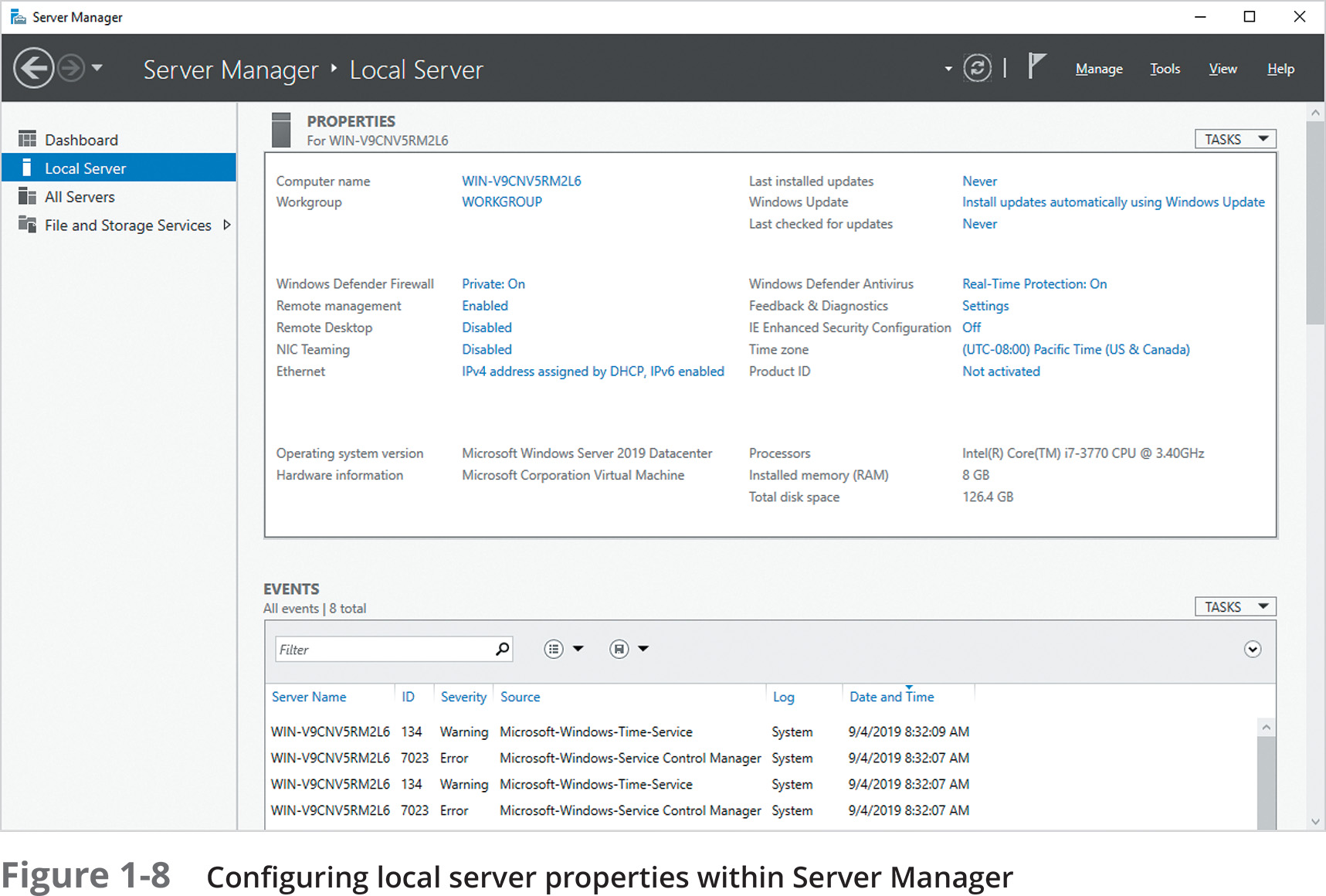
Windows Server 2019 Features (7 of 11)

Slide 20
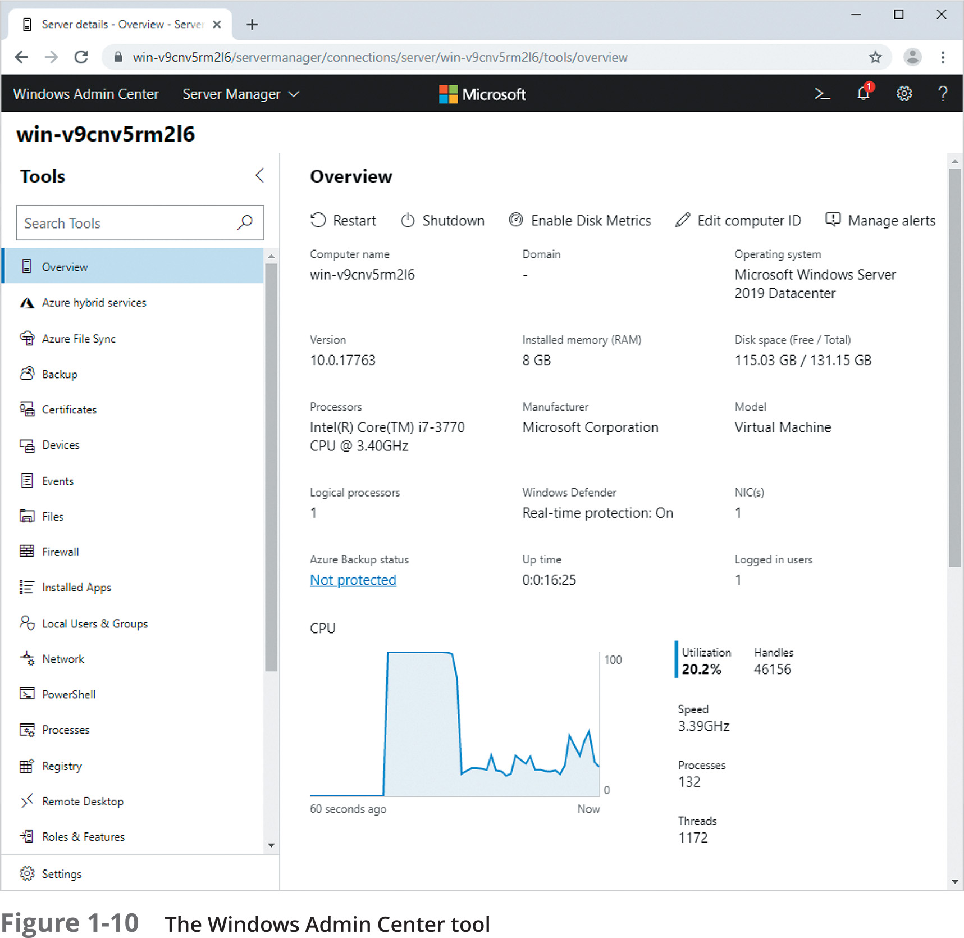
Windows Server 2019 Features (8 of 11)

Slide 21
Windows Server 2019 Features (9 of 11)
Small footprint installation options
Install Server 2019 with a minimal set of services, features, and functionality
Produces a smaller attack surface
More suitable for cloud environments
Uses far less server storage, memory, and processor resources
Can be installed within a virtual machine or used as a container
Windows Server 2019 offers two small footprint installation options
Server Core and Nano Server

Slide 22
Windows Server 2019 Features (10 of 11)
Hybrid cloud features
Hybrid cloud
Integration between on-premises Windows Servers and Windows Servers and services running within the Azure cloud
Windows Server Azure Network Adapter feature
Azure Backup feature
Azure Update Management feature
Azure Site Recovery feature
Kubernetes software coordinates container execution

Slide 23
Windows Server 2019 Features (11 of 11)
Linux application support
Web apps running in the cloud run within Linux containers
Microsoft’s Windows Subsystem for Linux (WSL)
Makes it easier for Web app developers to create and test Linux apps on their Windows 10 PCs

Slide 24
Windows Server 2019 Editions (1 of 3)
Table 1-1: Comparing the major Windows Server 2019 editions
Limitations | Essentials Edition | Standard Edition | Datacenter Edition
Maximum users | 25 | Limited by number of CALs | Limited by number of CALs
Licensing | Per server | Per processor core | Per processor core
Maximum memory | 64 GB | 24 TB | 24 TB
Maximum processor sockets | 2 | 64 | 64
Can join a domain | Only to enable migration | Yes | Yes
Maximum file sharing connections | 16.8 million | 16.8 million | 16.8 million
Maximum remote access connections | 50 | Unlimited | Unlimited
Hyper-V | No | Yes (2 virtual machines) | Yes (unlimited virtual machines)
Containers | No | Yes (unlimited) | Yes (unlimited)
Hyper-V containers | No | Yes (up to 2) | Yes (unlimited)

Slide 25
Windows Server 2019 Editions (2 of 3)
Windows Storage Server 2019
Cannot be purchased directly from Microsoft
OEMs can offer Windows Storage Server 2019 on the server-based products they sell
Windows Storage Server 2019 turns a server into a central storage center for data in an organization
Takes advantage of the storage utilities offered in Windows Server 2019

Slide 26
Windows Server 2019 Editions (3 of 3)
Microsoft Hyper-V Server 2019
Hyper-V hypervisor
Free to download and use
Each Windows Server virtual machine running it requires a valid license
Note: Linux virtual machines do not require a license
Installs a small footprint version of Windows Server
Contains a PowerShell interface for creating and managing virtual machines

Slide 27
Preparing for a Windows Server 2019 Installation (1 of 3)
Perform advanced planning
Review and exceed minimum hardware requirements
Consider capacity planning questions
Consider processing speed, paying attention to the number of processors
Ensure server has enough memory for the applications that it will host
Consider the amount and type of storage
Redundant Array of Independent Disks (RAID) in the BIOS of the server
Additional hard disks, SSDs, virtual machine hard disk files

Slide 28
Preparing for a Windows Server 2019 Installation (2 of 3)
Table 1-2: Minimum hardware requirements for Windows Server 2019
Hardware | Minimum requirements | Additional considerations
Basic Input/Output System (BIOS) | Unified Extensible Firmware Interface (UEFI) 2.3.1c BIOS or higher for physical server installation | Trusted Platform Module (TPM) is also required for secure boot and encryption features.
Processor | 1.4 GHz 64-bit processor (includes support for NX, DEP, CMPXCHG16b, LAHF/SAHF, PrefetchW, EPT, or NPT) | Processor clock speed, amount of processor cache, and number of processor cores should be considered based on planned usage. Hyper-V also requires processor virtualization extensions (Intel VT or AMD-V, with SLAT).
Memory | 512 MB (2 GB for a server with the GUI desktop) | Each virtual machine requires 800 MB for setup (although this can be scaled back after setup is complete). ECC memory is recommended for physical (non-virtualized) server installations.
Storage | 32 GB | 32 GB is the minimum for Server Core, while 36 GB is the minimum for installing a full Windows Server.

Slide 29
Preparing for a Windows Server 2019 Installation (3 of 3)
Table 1-2: Minimum hardware requirements for Windows Server 2019
Hardware | Minimum requirements | Additional considerations
Network interface | 1 gigabit or faster Ethernet adapter that is compatible with PCI Express architecture and Pre-boot Execution Environment (PXE) | Additional adapters are recommended if you support multiple virtual machines.
Optical drive | DVD drive (optional) | While a DVD drive is needed for installations from DVD media, many administrators install from a USB drive today.
Display | Super VGA at 1024 3 768 or higher resolution | Multiple servers can share one display via the use of a keyboard video-mouse (KVM) switch.
Interactive devices | Keyboard and pointing device | Multiple servers can share a keyboard and pointing device via the use of a KVM switch box.

Slide 30
Installing Windows Server 2019
Installation broken into three separate tasks
Obtaining installation media
Starting the installation process
Completing the installation process

Slide 31
Obtaining Installation Media
Common method used to install Windows Server
Booting a computer or virtual machine from installation media
Bootable DVD or USB flash drive or ISO image file
Use disk-burning software to download ISO image: Burnaware or Rufus
Download the correct Windows Server 2019 ISO image file

Slide 32
Starting the Installation Process
Ensure BIOS boot order if necessary
Create a new virtual machine within a virtualization configuration program
Attach an ISO image file to the virtual DVD drive within the virtual machine
Configure the virtual machine BIOS boot order
Boot from a DVD before the virtual hard disk file
Start virtual machine within the virtual machine software
Machine boots ISO image attached to the virtual DVD
Installation process starts

Slide 33
Completing the Installation Process (1 of 8)
First step: enter regional locale and keyboard format
Second step: choose whether to start an installation or repair a system
Third step: select desired Windows Server 2019 edition
Accept the Microsoft license terms for Windows Server 2019
Fourth step: select installation type – custom or upgrade
Normally, select Custom installation for new installation
Fifth step: select Windows Server operating system storage location
Reboot and specify a password for the local Administrator user account

Slide 34
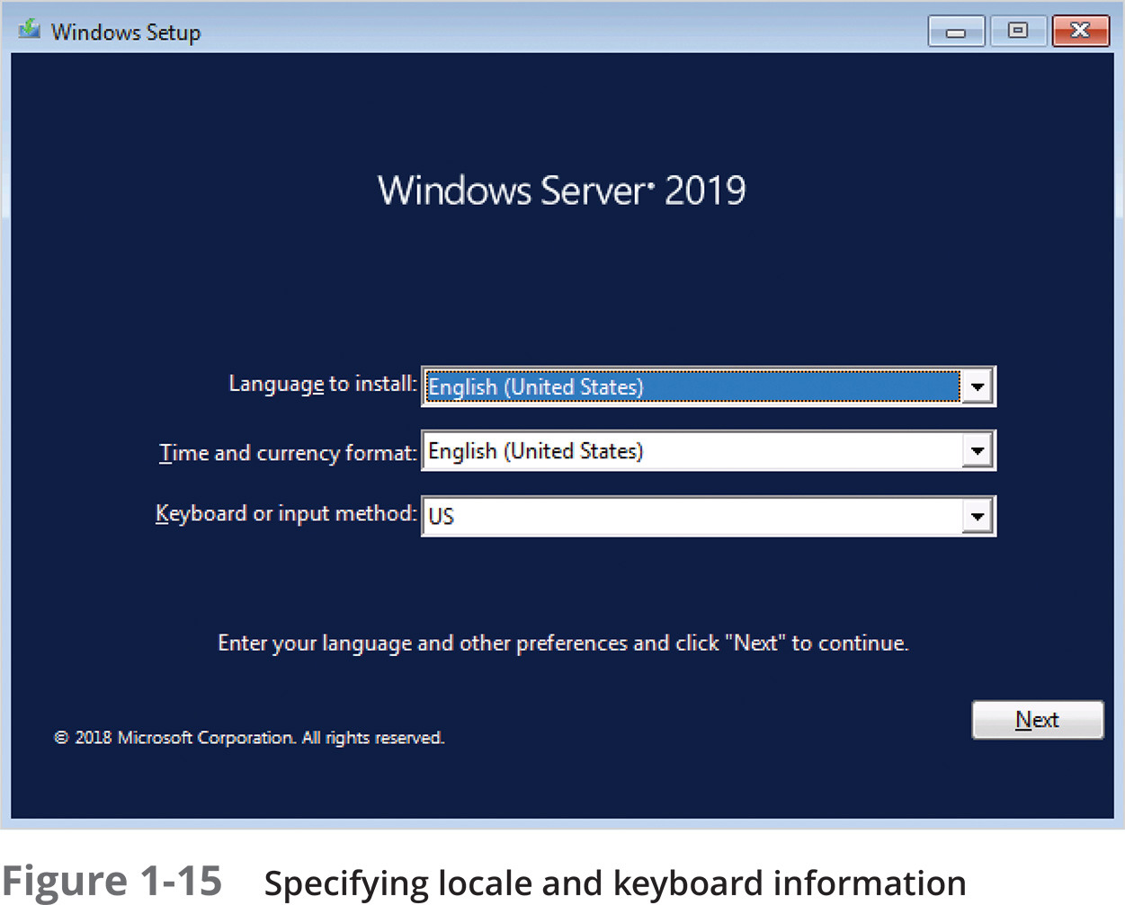
Completing the Installation Process (2 of 8)

Slide 35
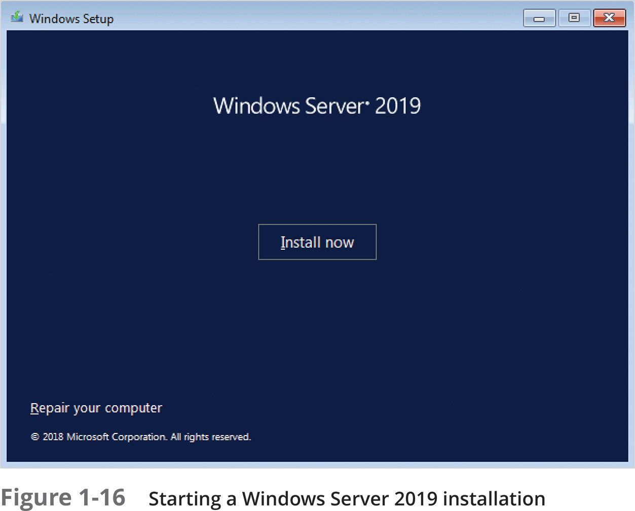
Completing the Installation Process (3 of 8)

Slide 36
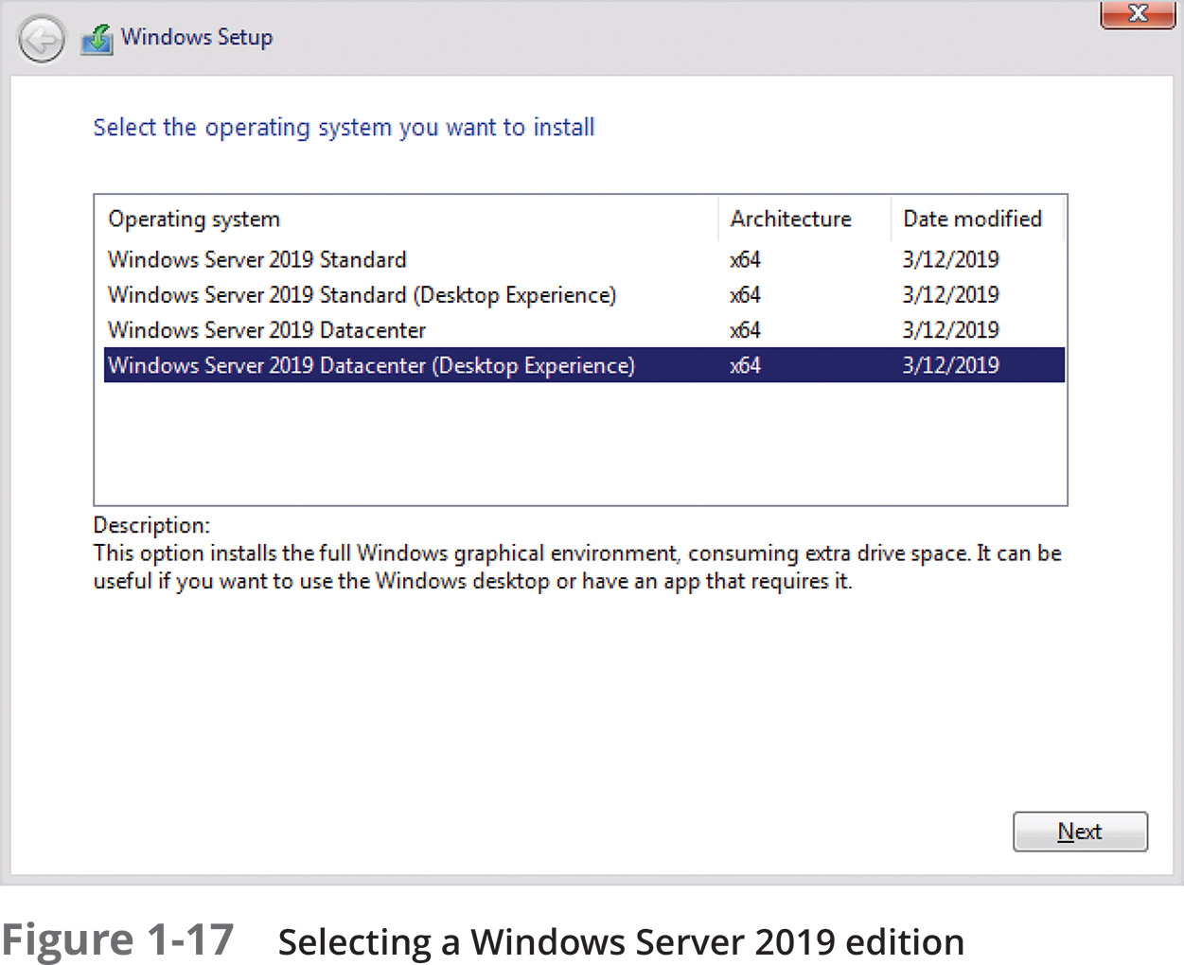
Completing the Installation Process (4 of 8)

Slide 37
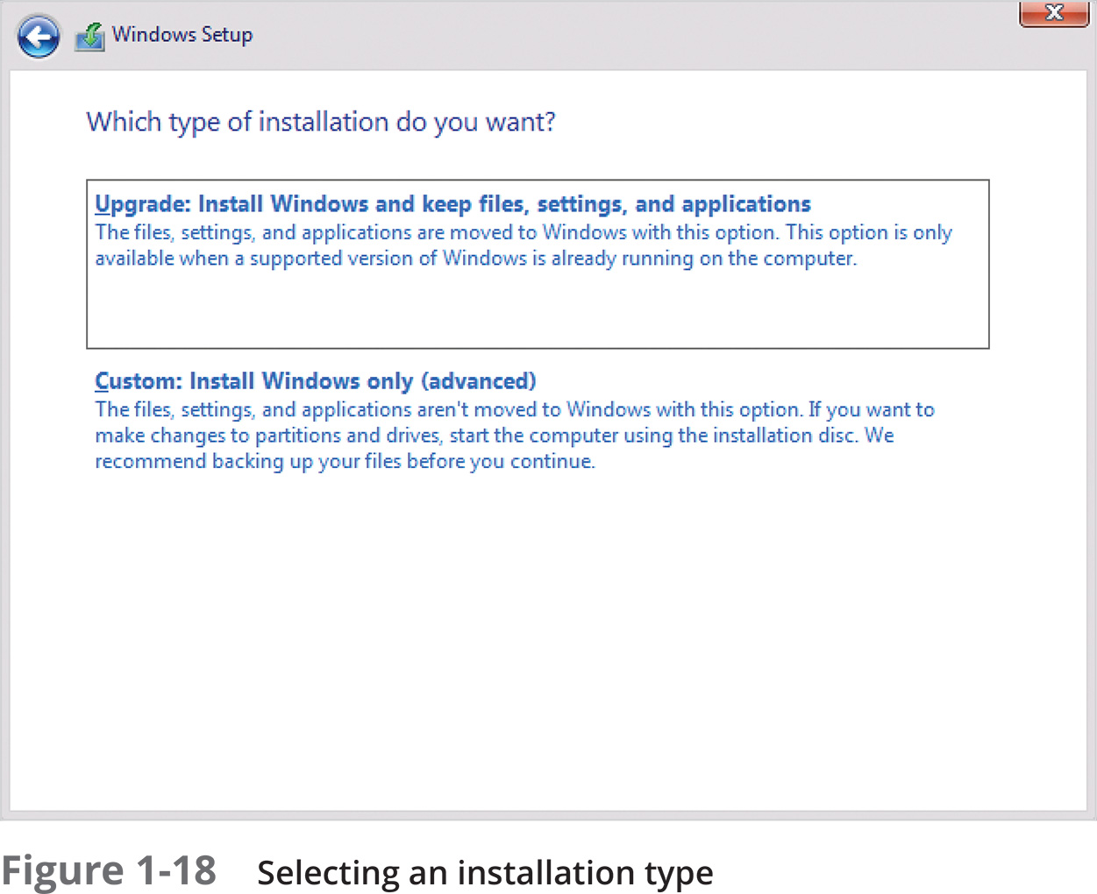
Completing the Installation Process (5 of 8)

Slide 38
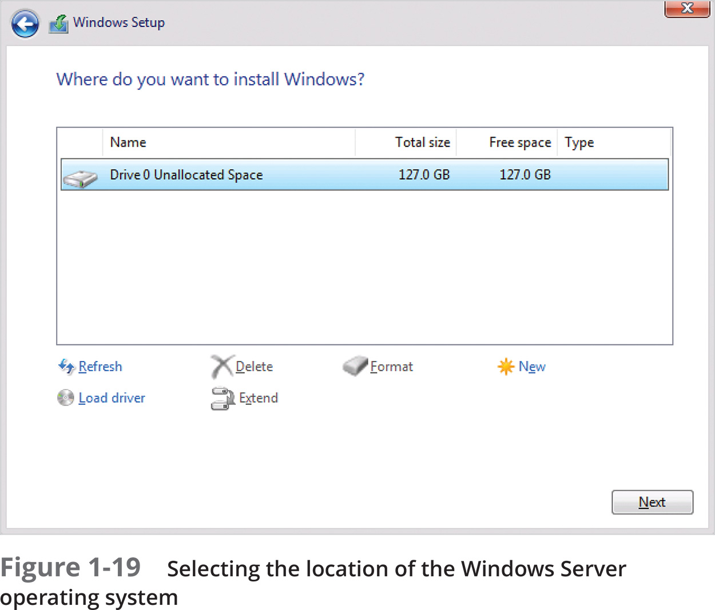
Completing the Installation Process (6 of 8)

Slide 39
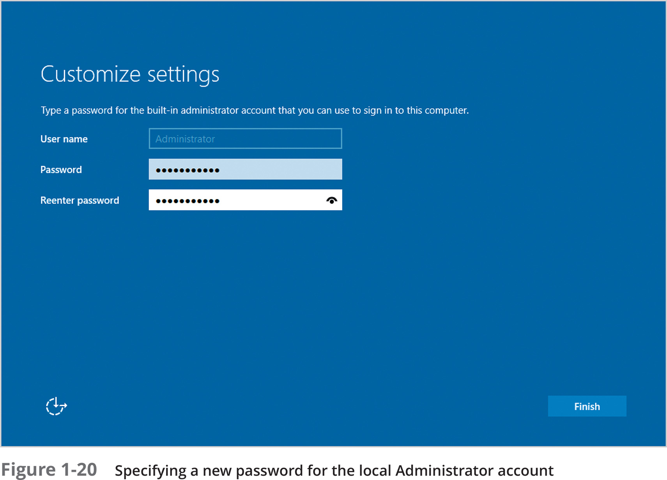
Completing the Installation Process (7 of 8)

Slide 40
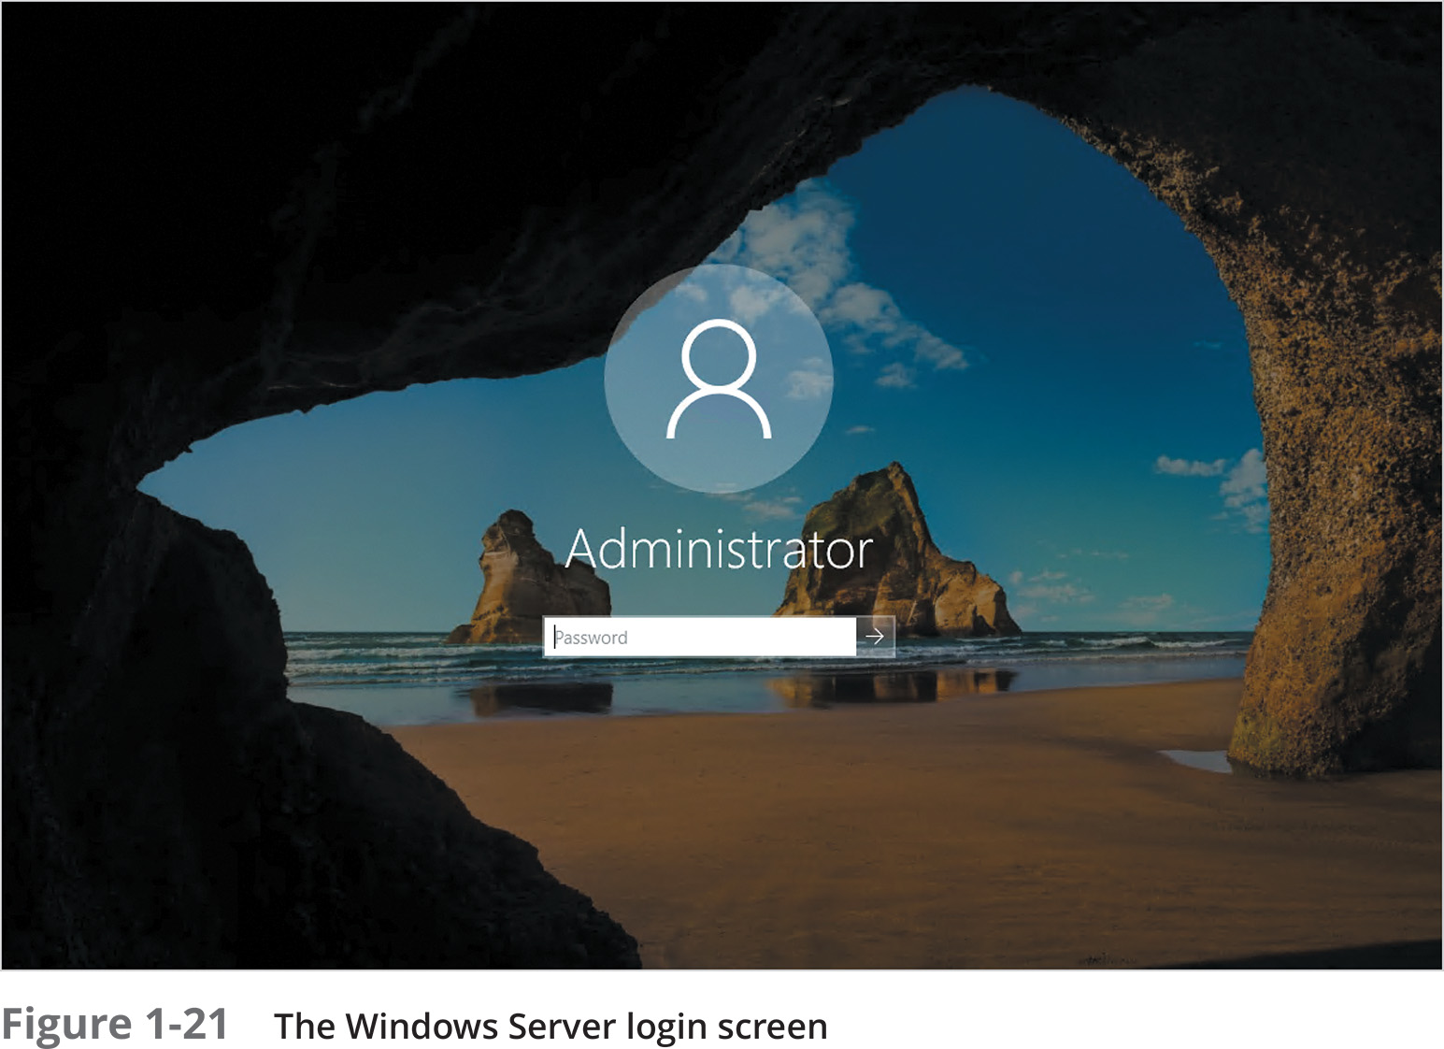
Completing the Installation Process (8 of 8)

Slide 41
Post-Installation Configuration
Key configuration tasks following any Windows Server 2019 installation
Setting the correct time and time zone
Configuring the Internet Protocol (IP) on the server’s network interfaces
Configuring the firewall
Changing the default computer name and domain membership
Installing a modern Web browser
Activating the Windows Server operating system

Slide 42
Setting the Correct Time and Time Zone
Within Server Manager
Navigate to Local Server
Select the hyperlink to Time zone in the Properties window
Within the Windows Server Configuration Wizard on Server Core
Select option 9

Slide 43
Configuring the Network (1 of 5)
Requirements to connect computer to a network
Network interface, protocol, packets, routers, and other devices on a network
Three default Windows protocols
TCP/IP, UDP/IP, ICMP
TCP ensures retransmission of lost packets
IP network participant requires a valid Internet Protocol (IP) address
IP version 4 (IPv4)
IP version 6 (IPv6)

Slide 44
Configuring the Network (2 of 5)
Understanding IPv4
Participation on an IPv4 network
Requires valid IP address and a subnet mask
Optionally requires configuration of a default gateway
Unicast communication: from one computer to another computer using IP
Octets: most common format for IPv4 addresses
IPv4 address’s two parts: network ID and host ID
IPv4 address must be configured with a subnet mask

Slide 45
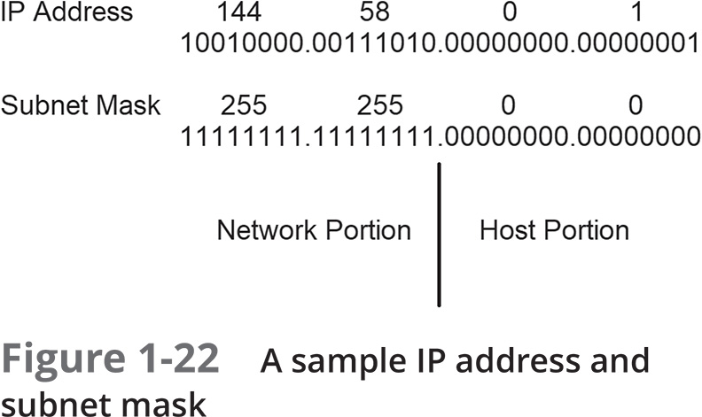
Configuring the Network (3 of 5)

Slide 46
Configuring the Network (4 of 5)
Understanding IPv6
Accommodates far more IP addresses: uses 128 bits to identify computers
IP addresses written using 8 colon-delimited 16-bit hexadecimal numbers
IPv6 addresses can be expressed several ways
Adopted by small Internet-connected devices
Collectively referred to as the Internet of Things (IoT)
Uses Teredo protocol to work within IPv4-only networks
Proxy servers and Network Address Translation (NAT) routers allow more IPv4 addresses

Slide 47
Configuring the Network (5 of 5)
Configuring IP on a network interface
Automatic from Dynamic Host Configuration Protocol (DHCP) or Boot Protocol (BOOTP) server
Process varies on IPv4 or IPv6 networks
Automatic address assignment features
Automatic Private IP Addressing (APIPA)
Internet Control Message Protocol version 6 (ICMPv6)
Can manually configure IP on a network interface within Server Manager

Slide 48
Configuring the Firewall
Perimeter network or demilitarized zone (DMZ)
Contains servers surrounded by routers
Routers implement advanced firewall capabilities for traffic passing into network
Disable or modify DMZ servers’ firewall configurations within Server Manager
Navigate to Local Server
Select hyperlink next to Windows Defender Firewall in the Properties window

Slide 49
Changing the Default Computer Name and Domain Membership
Installation assigns randomly generated computer name for the server
Change within Server Manager
Navigate to Local Server
Select hyperlink next to Computer name in the Properties window
Click the Change button and supply a new computer name
Change within Windows Server Configuration Wizard on Server Core
Select option 2
Finish by joining the server to a domain

Slide 50
Installing a Modern Web Browser
Default Windows Server 2019 Web browser: Internet Explorer
Provided for legacy application support only
Internet Explorer Enhanced Security Configuration (IE ESC) blocks Web sites
Disable IE ESC within Server Manager
Navigate to Local Server
Select hyperlink next to IE Enhanced Security Configuration in the Properties window
Disable IE ESC for all users or system administrators

Slide 51
Activating the Windows Server Operating System
Automatic activation performed based on Generic Volume License Key (GVLK)
Requires organization’s Key Management Services (KMS) installed on a network server
Requires Active Directory-based Activation role installed on a domain controller within the domain
Organization can purchase a retail product key or Multiple Activation Key (MAK)
Activation within Server Manager by navigating to Local Server
Select hyperlink next to Product ID in the Properties window
Enter license key and click Activate to complete the activation process

Slide 52
Selecting a Windows Server 2019 Lab Environment
Hands-On Projects within this book will require Hyper-V
Can install Windows Server 2019 directly on a computer
Not necessarily practical
Can use Windows 10 Professional, Enterprise, and Education editions
These releases provide support for Hyper-V and nested virtualization

Slide 53

Summary
Windows Server 2019 installs on an on-premises rackmount server or a VM
Microsoft’s Hyper-V is often used with the nested virtualization feature
Windows Server 2019 has many key features and containers to host Web apps
Several tools are used to configure and manage Windows Server 2019
Server Core and Nano Server are two small footprint installation options
Three major editions of Windows Server 2019 exist
Several installation and post-installation tasks are typically performed

